Slide 1

Mass Data Processing And Analysis Using Data Brew And Data Glew
SUBMITTED BY
22NE1A0429-Doredla Bhuvan kumar
22NE1A0418-Boddu Divya
22NE1A0421-Bora Gangothri
22NE1A0433-Shaik Karishma NAZMOON

Slide 2
Abstract
Mass data processing and analysis have become crucial in handling vast datasets efficiently. AWS offers robust solutions like AWS Data Brew and AWS Glue for these purposes Data Brew is a visual data preparation tool that enables users to clean and normalize data without writing code. It simplifies data wrangling tasks through an intuitive interface, providing over 250 pre-built transformations to automate repetitive data preparation tasks. Data Brew supports a wide range of data sources, allowing seamless integration with data lakes, data warehouses, and other AWS services Glue, on the other hand, is a fully managed extract, transform, and load (ETL) service that makes it easy to prepare and load data for analytics. Glue automatically discovers and catalogs metadata about data stores, streams, and datasets, reducing the manual effort in setting up ETL jobs.

Slide 3
INTRODUCTION
The exponential growth of data in recent years has presented both opportunities and challenges for organizations across various sectors. As data becomes increasingly central to decision-making, the need for efficient and scalable data processing and analysis tools has never been greater. Companies are tasked with managing vast amounts of data from diverse sources, requiring robust solutions that can handle complex data workflows while ensuring data quality and integrity. Amazon Web Services (AWS) has emerged as a leading provider of cloud-based solutions for data processing and analysis. Among its extensive suite of tools, AWS Data Brew and AWS Glue stand out as powerful services designed to streamline and automate data preparation and ETL (Extract, Transform, Load) processes. This introduction delves into the significance of these tools in the context of mass data processing and analysis, highlighting their key features, benefits, and applications

Slide 4
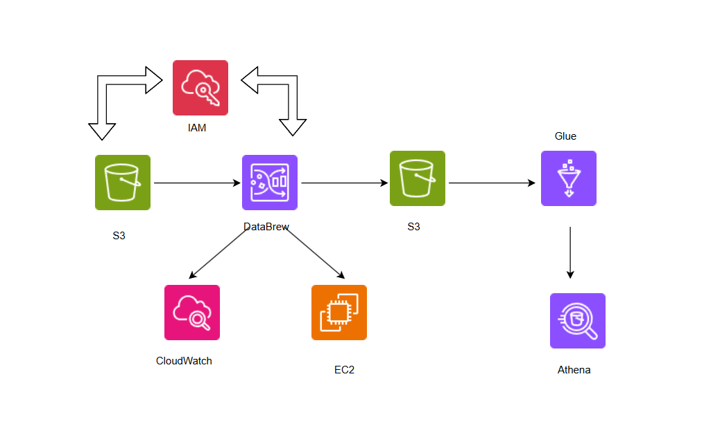
SERVICES USED:
Amazon S3 bucket
Amazon Databrew
Amazon Glue
Amazon Athena
Figure :architeture of mass dataprocessing

Slide 5
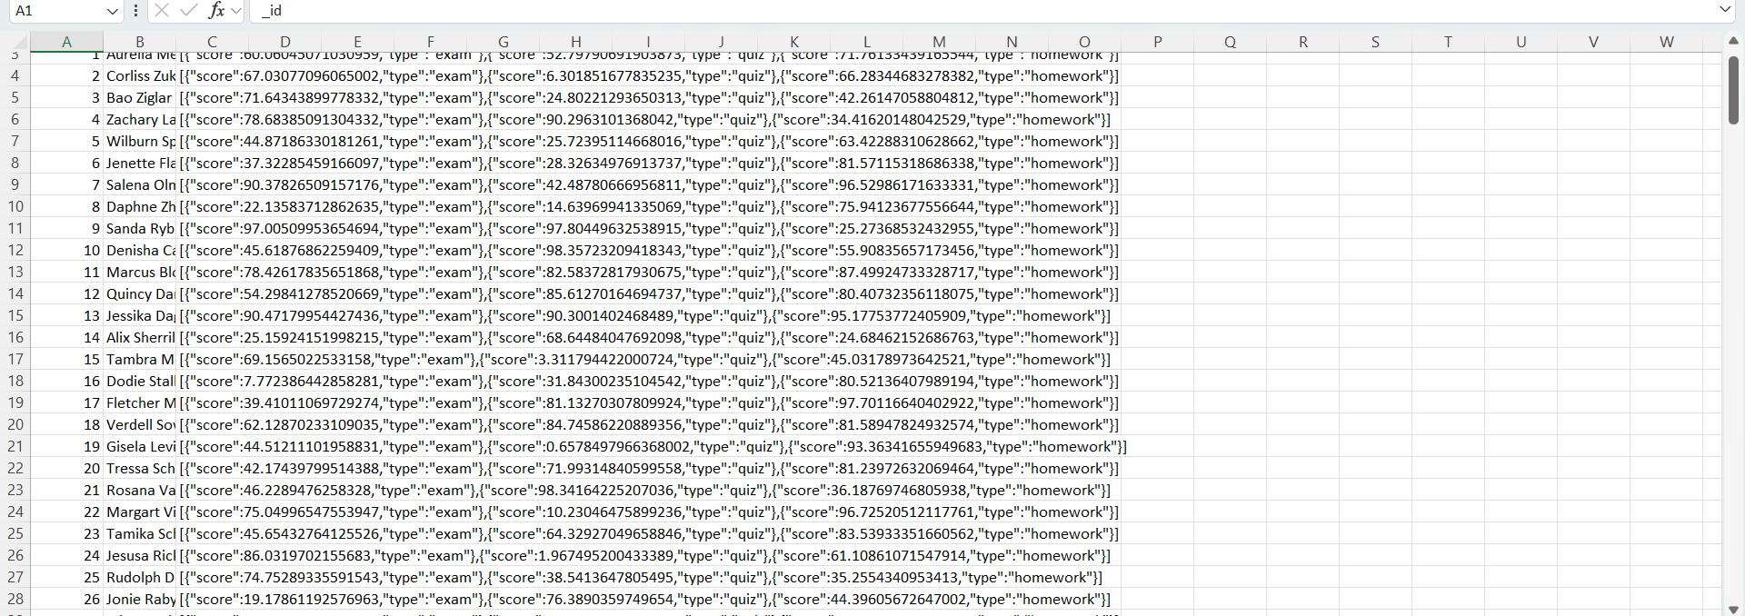

JSON FILE
A JSON (JavaScript Object Notation) file is a file that stores data in a structured, readable format.
It is primarily used for data exchange between a server and a web application, but it can also be used for configuration files and storing structured data.

Slide 6
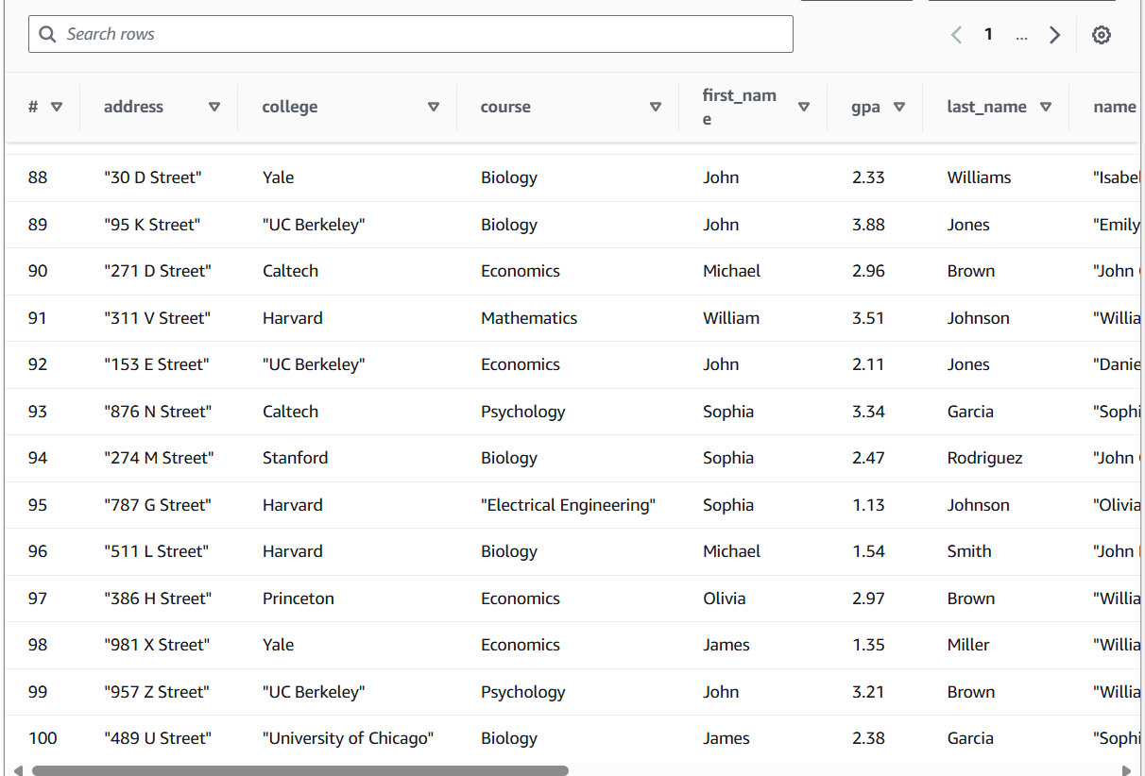

CSV FILE
A CSV (Comma-Separated Values) file is a plain text file that uses a comma to separate values.
Each line in a CSV file corresponds to a row in a table, and each value in the line corresponds to a cell in that row.
It's commonly used for exporting and importing data in a tabular format between different software applications, especially spreadsheets and databases.

Slide 7
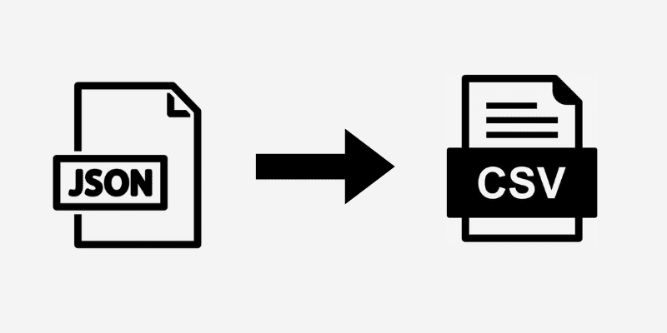
JSON FILE TO CSV FILE
To convert a JSON file to a CSV file using AWS Glue and AWS Glue DataBrew, you can follow these steps:
Go to the AWS Glue console. - Create a new crawler to crawl the JSON file and create a table in the Glue Data Catalog.
Create a Job: Create a new Glue ETL job. - Choose the table created by the crawler as the data source.
In the script generated, modify it to output the data to a CSV file. The script would look something like this:

Slide 8
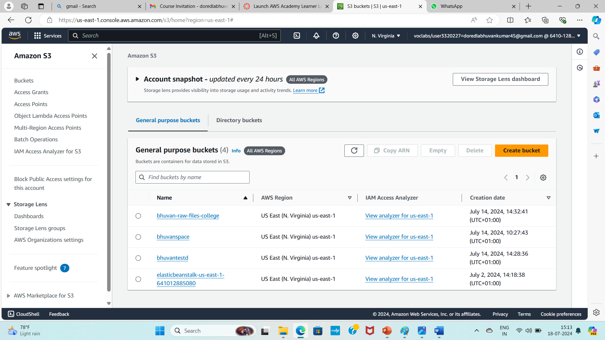

S3 Bucket
Amazon S3 (Simple Storage Service) is a scalable, high-speed, low-cost web-based service designed for online backup and archiving of data and application programs.
An S3 bucket is a container for storing objects (which consist of data and metadata) within the S3 service.
Each bucket has a globally unique name and can store an unlimited number of objects, each of which can be up to 5 terabytes in size.
Buckets can be configured with various settings, such as permissions, versioning, and lifecycle policies to manage the data over time..

Slide 9
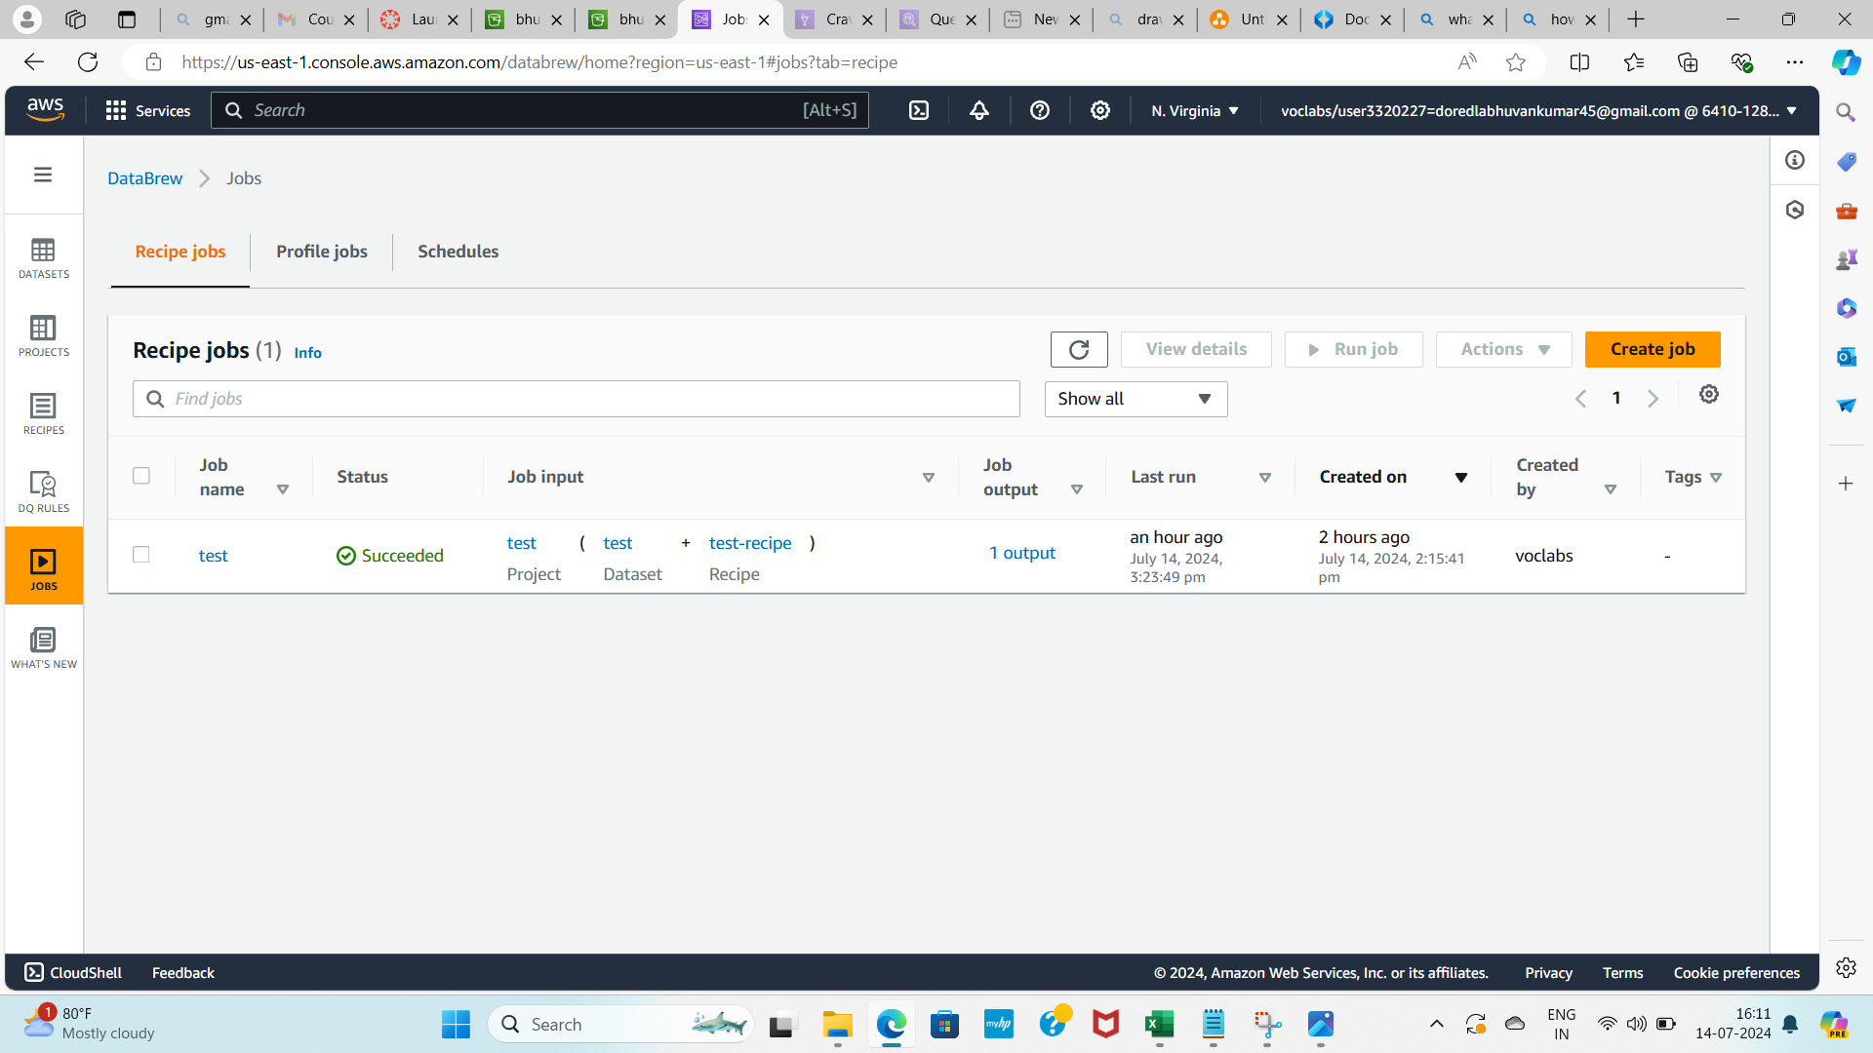

Amazon Databrew
Visual Interface: DataBrew provides a visual interface to interact with data. Users can profile data, detect anomalies, and apply transformations through a point-and-click interface.
Data Preparation Steps: Users can apply over 250 pre-built transformations, such as filtering, grouping, and normalization, to prepare data for machine learning, analytics, and data warehousing.
Data Sources: DataBrew can connect to various data sources, including Amazon S3, Amazon Redshift, Amazon RDS, and other AWS services, as well as third-party sources.

Slide 10
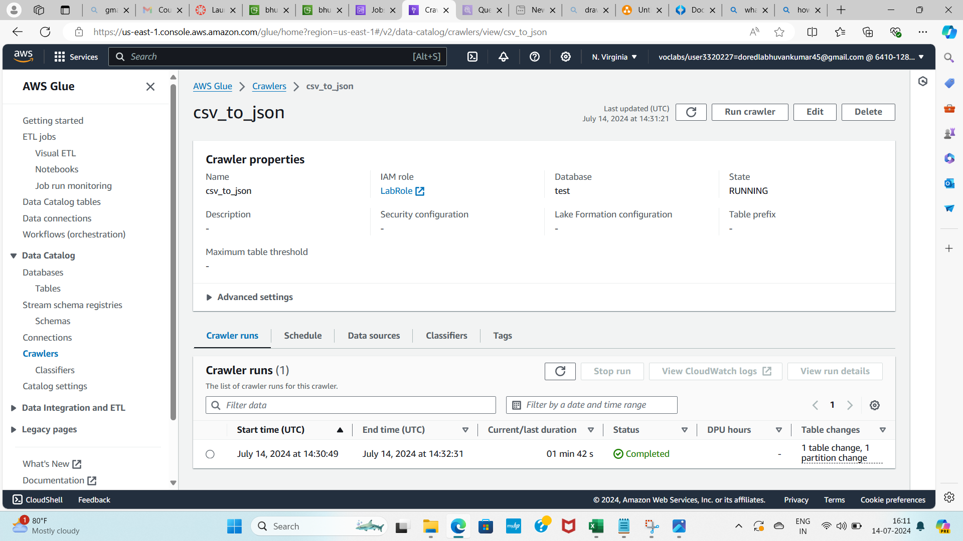

AWS GLUE
AWS Glue is a fully managed extract, transform, and load (ETL) service provided by Amazon Web Services.
It is designed to help you prepare and load data for analytics.
With AWS Glue, you can discover and connect to different data sources, transform and clean data to be consistent and useful, and then move it reliably between various data stores and data lakes.

Slide 11
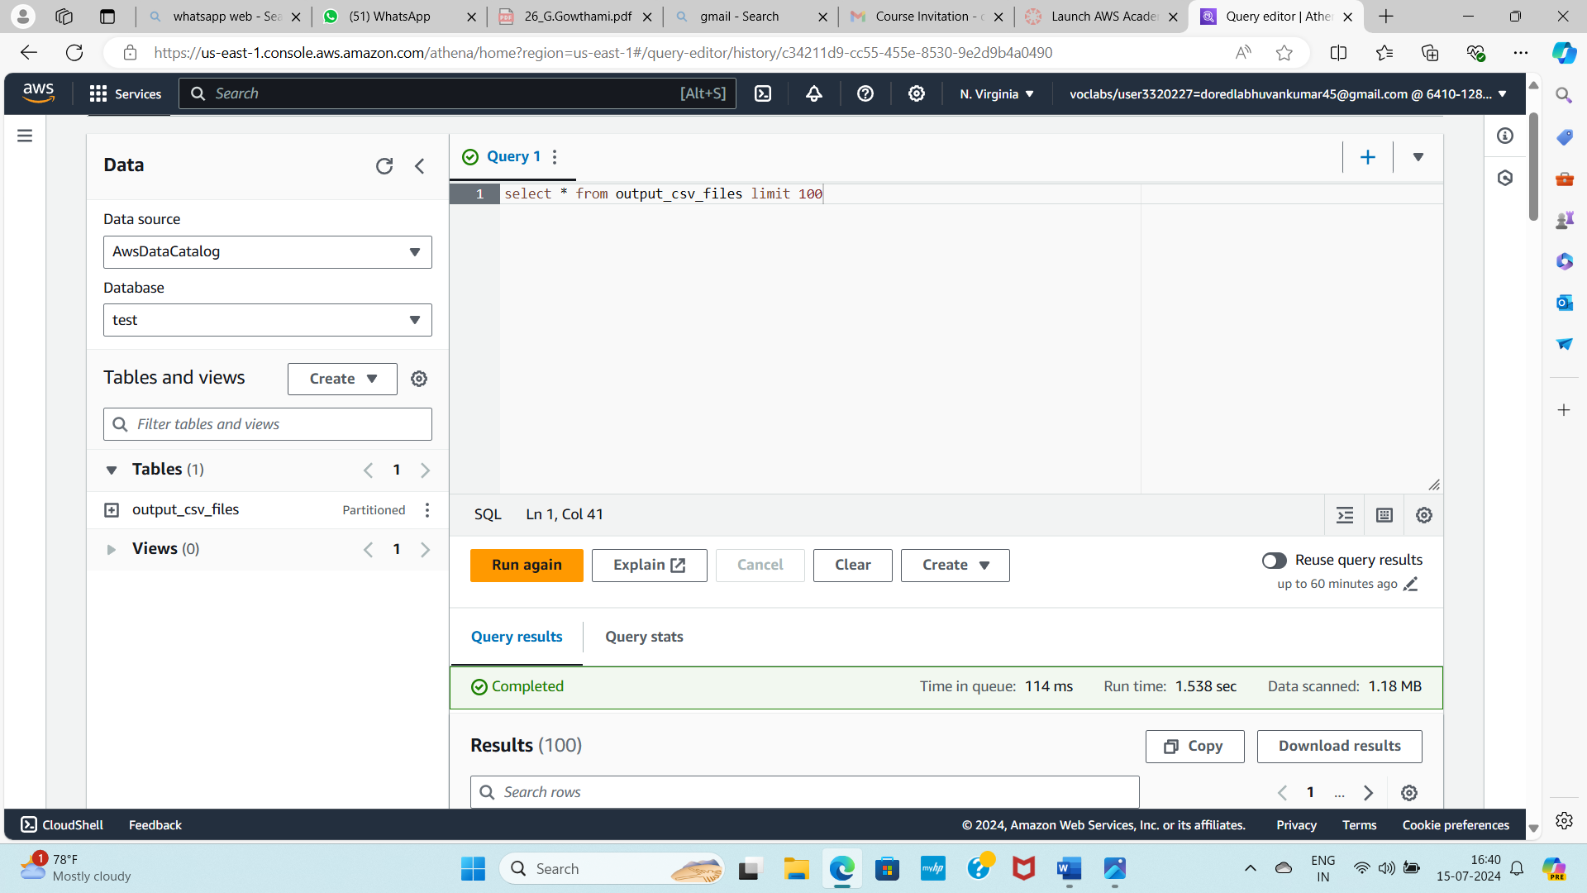

ATHENA
Amazon Web Services (AWS) Athena is an interactive query service that allows you to analyze data in Amazon S3 using standard SQL.
Athena is serverless, meaning there is no infrastructure to manage, and you pay only for the queries you run.
It is designed to be easy to use, requiring no complex setup or management, and supports a variety of data formats such as CSV, JSON, ORC, Avro, and Parquet.
Athena is commonly used for quick, ad-hoc querying and analysis of large datasets stored in S3.

Slide 12
conclusion
Mass data processing and analysis have become essential in deriving actionable insights from large datasets. AWS Glue and AWS DataBrew streamline this process by providing robust tools for data integration, preparation, and transformation. AWS Glue automates the discovery, cataloging, and ETL (Extract, Transform, Load) processes, enabling seamless integration and movement of data across different sources. AWS DataBrew offers a visual, code-free interface to clean and normalize data, making it accessible to users without deep technical expertise.
Together, these services enhance data accuracy, consistency, and accessibility, facilitating more effective analysis and decision-making. Their scalability and serverless architecture reduce operational overhead and costs, allowing organizations to focus on deriving value from their data. Overall, AWS Glue and DataBrew empower businesses to efficiently handle and analyze large volumes of data, driving innovation and competitive advantage.

Slide 13


